Slide 1
Community Outreach
Meeting
August 20, 2020

Slide 2
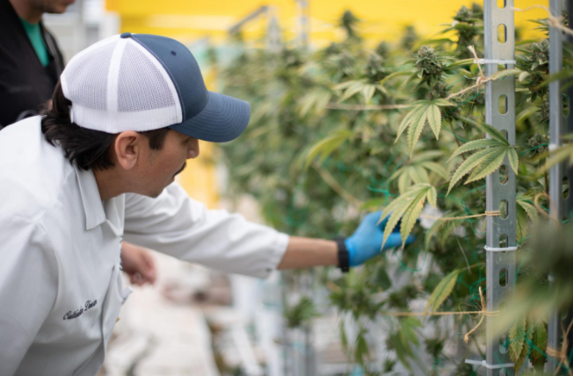
Calyx Peak - Background
Calyx Peak Companies is a leader of the legal cannabis revolution. We are committed to shaping the industry by creating and growing businesses that bring the highest levels of integrity, innovation and standards to this formerly unregulated field of business.
Founded in early 2016, Calyx Peak is a multi-state operator with current operations in California and Nevada, with additional licenses in California, Massachusetts and Missouri.
Our award-winning cannabis flower (four Top 10 finishes in the Emerald Cup) and our team’s deep retail experience will be valuable assets to the dispensary space in Massachusetts.

Slide 3
INTRODUCTION
Calyx Peak of MA, Inc. (Calyx Peak) is proposing to open an adult-use marijuana retailer at 16 New Ocean Street in the Town of Swampscott.
The property meets all current zoning requirements with the Town of Swampscott.
The proposed marijuana retailer must still complete the Host Community Agreement with the Town of Swampscott.
Calyx Peak will go through the State licensing process conducted by the Cannabis Control Commission (CCC).

Slide 4
INTRODUCTION
Calyx Peak’s proposed location is not within any Town established buffer zones.
Calyx Peak plans to replace the existing building with a new building. The new building will allow for better parking and will comply with all the security requirements of 935 CMR 500.
As a retail store only, the location will not constitute a nuisance to the community. There will not be any outside equipment beyond a normal retail store, so there will not be any more noise than any of the other retailers in the area. Additionally because it is only retail, there will not be any additional odor coming from the facility that could be detected from an adjacent property.

Slide 5
EXISTING LOCATION-
16 New Ocean Street

Slide 6
LOCATION- 16 New Ocean Street

Slide 7
LOCATION- 16 New Ocean Street

Slide 8
LOCATION- 16 New Ocean Street

Slide 9
SECURITY
Security is an import matter for Calyx Peak. Security goes well beyond the placement of cameras and other physical security measures. Security includes engagement with the community, the Police and Fire departments and most importantly, engagement with our team members.
Calyx Peak has incorporated security into many of the company policies, in one way or another. Calyx Peak is committed to our physical security, our security policies, including team member engagement and the Company’s engagement with the community and local law enforcement.

Slide 10
SECURITY
Calyx Peak has incorporated the following policies into the operation of our facility, in order to address security and the prevention of diversion.
Security
Prevention of diversion of marijuana to minors or the illicit market
Restricting Access to Age 21 and Older
Retail dispensing procedures
Personnel policies
Marijuana storage
Transportation and onsite deliveries both to and from the Marijuana Establishment

Slide 11
DIVERSION PREVENTION
Segregation
Marketing
Access Control
Reporting
Training
Policies and procedures will be implemented to reflect a segregation of duties where there are overlapping processes for diversion risk and ensure that the chain of custody and individual accountability are always maintained and verifiable .
Per CMR 500.105 (4)(a)(5), we will engage in reasonable marketing, advertising and branding practices that are not otherwise prohibited, that do not jeopardize the public health, welfare or safety of the general public or promote the diversion of marijuana or marijuana use in individuals younger than 21 years old.
Per CMR 500.110 (1)(f), we will store all product in a secure, locked safe or vault in such a manner as to prevent diversion, theft or loss. If diversion is detected, we will secure all product and conduct an assessment to determine whether additional safeguards are necessary.
Per CMR 500.105 (13)(b), Calyx Peak will document and report any unusual discrepancy in inventory to the Commission and law enforcement authorities not more than 24 hours after discovery.
Per CMR 500.105 (2)(b)(7)(b), Calyx Peak will require employees to complete annual trainings on all aspects of their jobs including diversion prevention, prevention of sales to minors, and best practices to detect and respond to incidents of possible diversion.

Slide 12
COMMUNITY IMPACT
Our goal is to be a good partner to the community, working with local government, law enforcement and the area businesses to enhance the neighborhood. We intend to create a positive economic impact beneficial to the Town of Swampscott and the neighborhood through the local sales tax and by off setting costs incurred by the Town through Calyx Peak’s Community Impact Fee.
Partnership
Security
Dialogue
Through our own security measures we will prevent on-site diversion and working with the Swampscott Police Department and area businesses, utilize our existing security measures to provide enhanced benefits to the neighborhood where possible.
We are committed to a continued dialogue with the Town of Swampscott and the neighborhood to foster a mutually beneficial, healthy, and safe partnership. Further as a Marijuana Establishment, we will provide information and education about our products.

Slide 13
QUESTIONS ?

