Slide 1
2020 Elections
Presented by Susan j. Duplin, town clerk

Slide 2
2020 ELECTIONS
March 3rd, 2020 Pres. Primary, April 28th Local, Sept 1st State Primary & Nov. 3rd Presidential
March 3, 2020 Presidential Primary
Feb. 12th Last Day to register to vote/change party affiliation
EARLY VOTING Monday, FEB. 24TH THRU Friday, FEB 28TH IN TOWN Hall
EV hours: Mon. thru Thurs. 8AM TO 8PM & Friday 8AM to 12PM
This Photo by Unknown Author is licensed under CC BY
This Photo by Unknown Author is licensed under CC BY-SA-NC

Slide 3
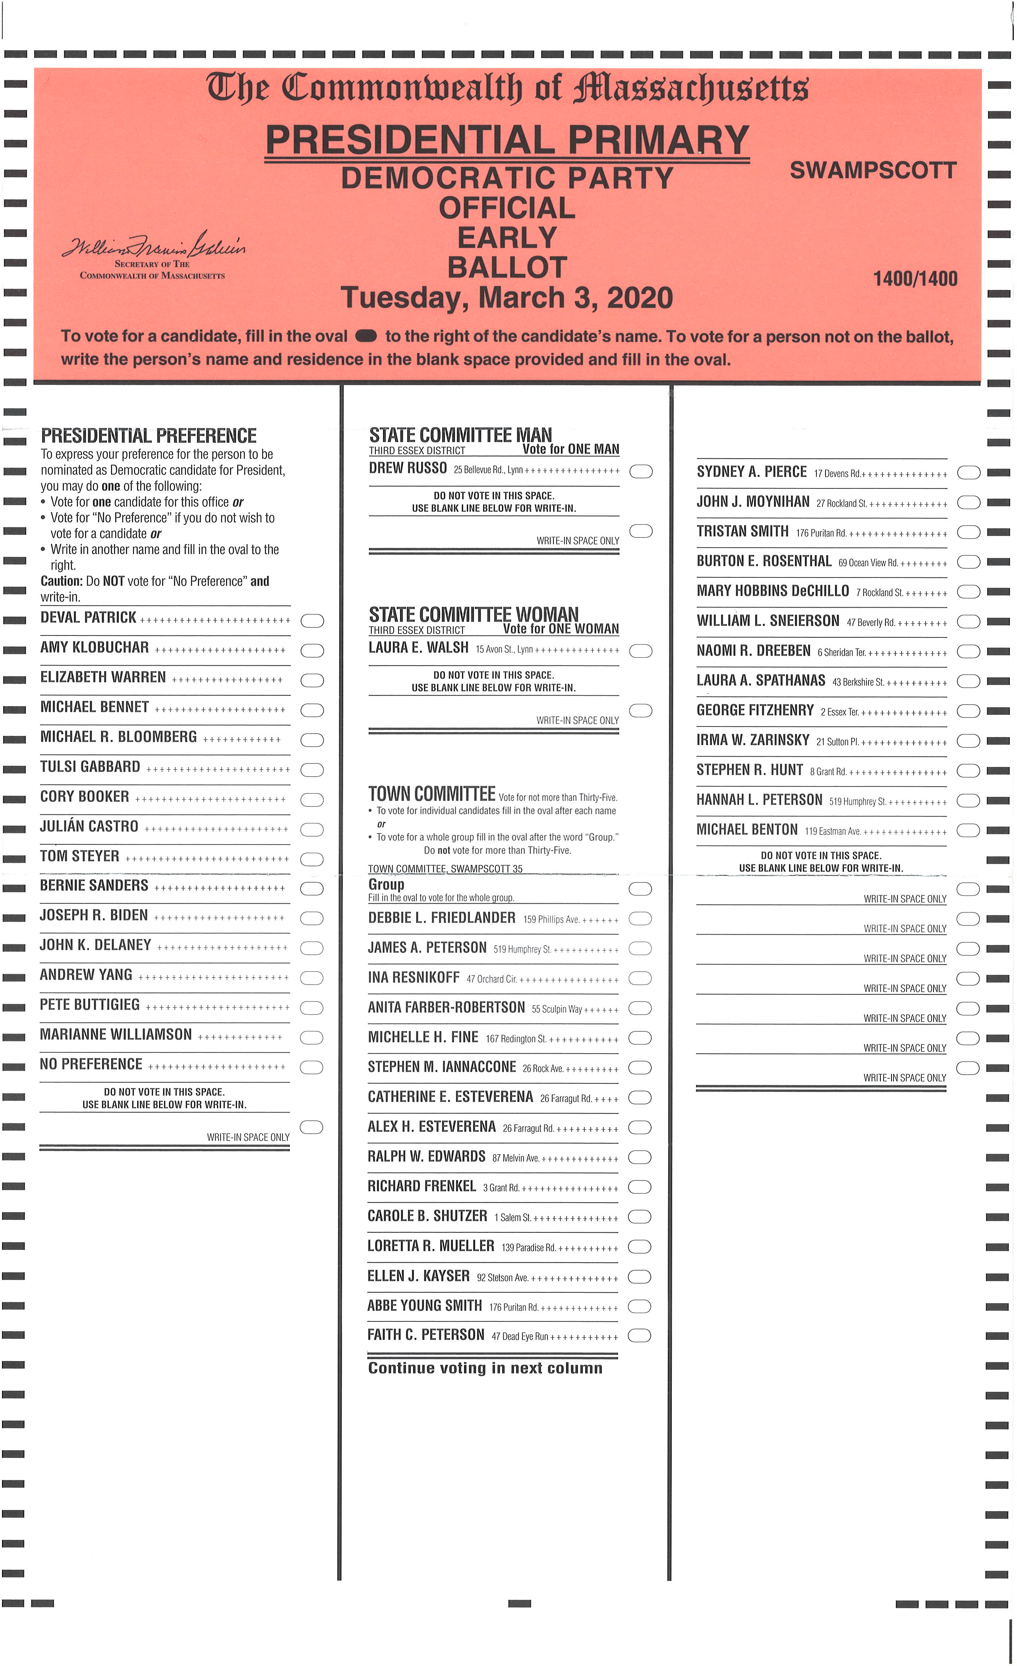
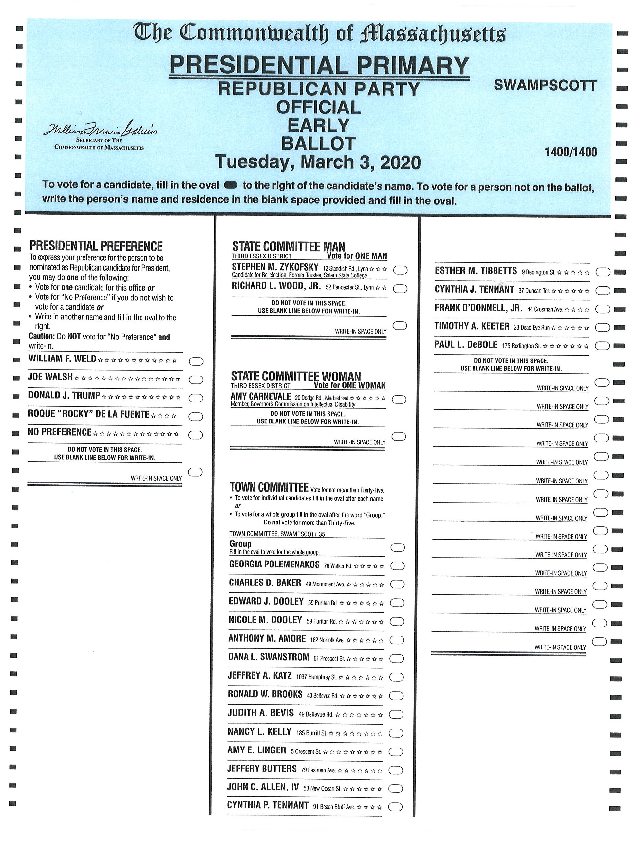
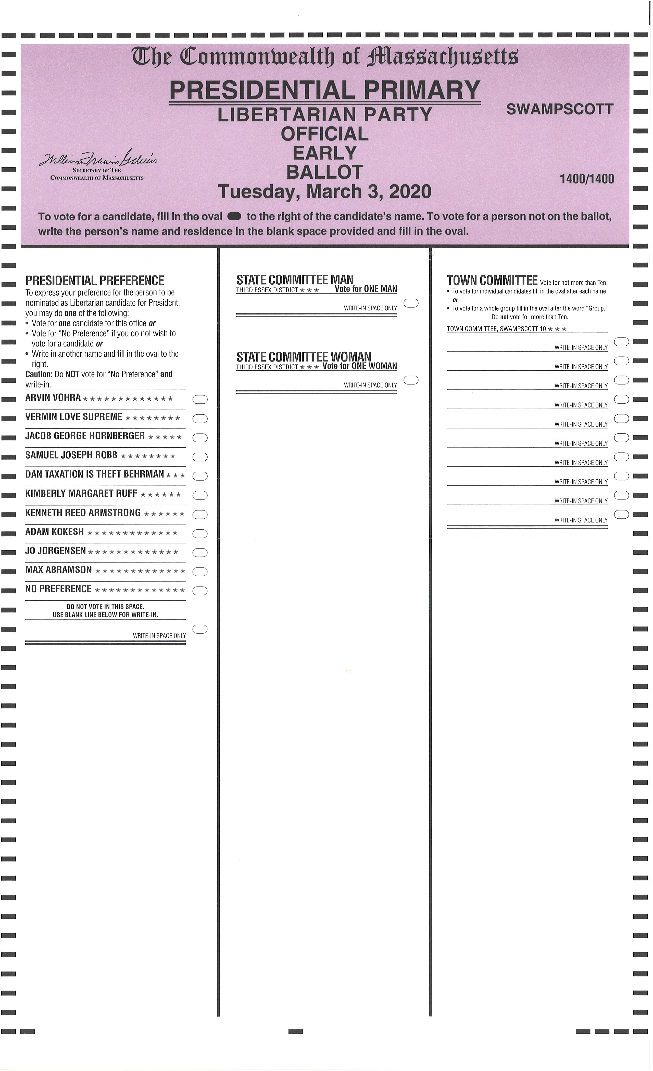
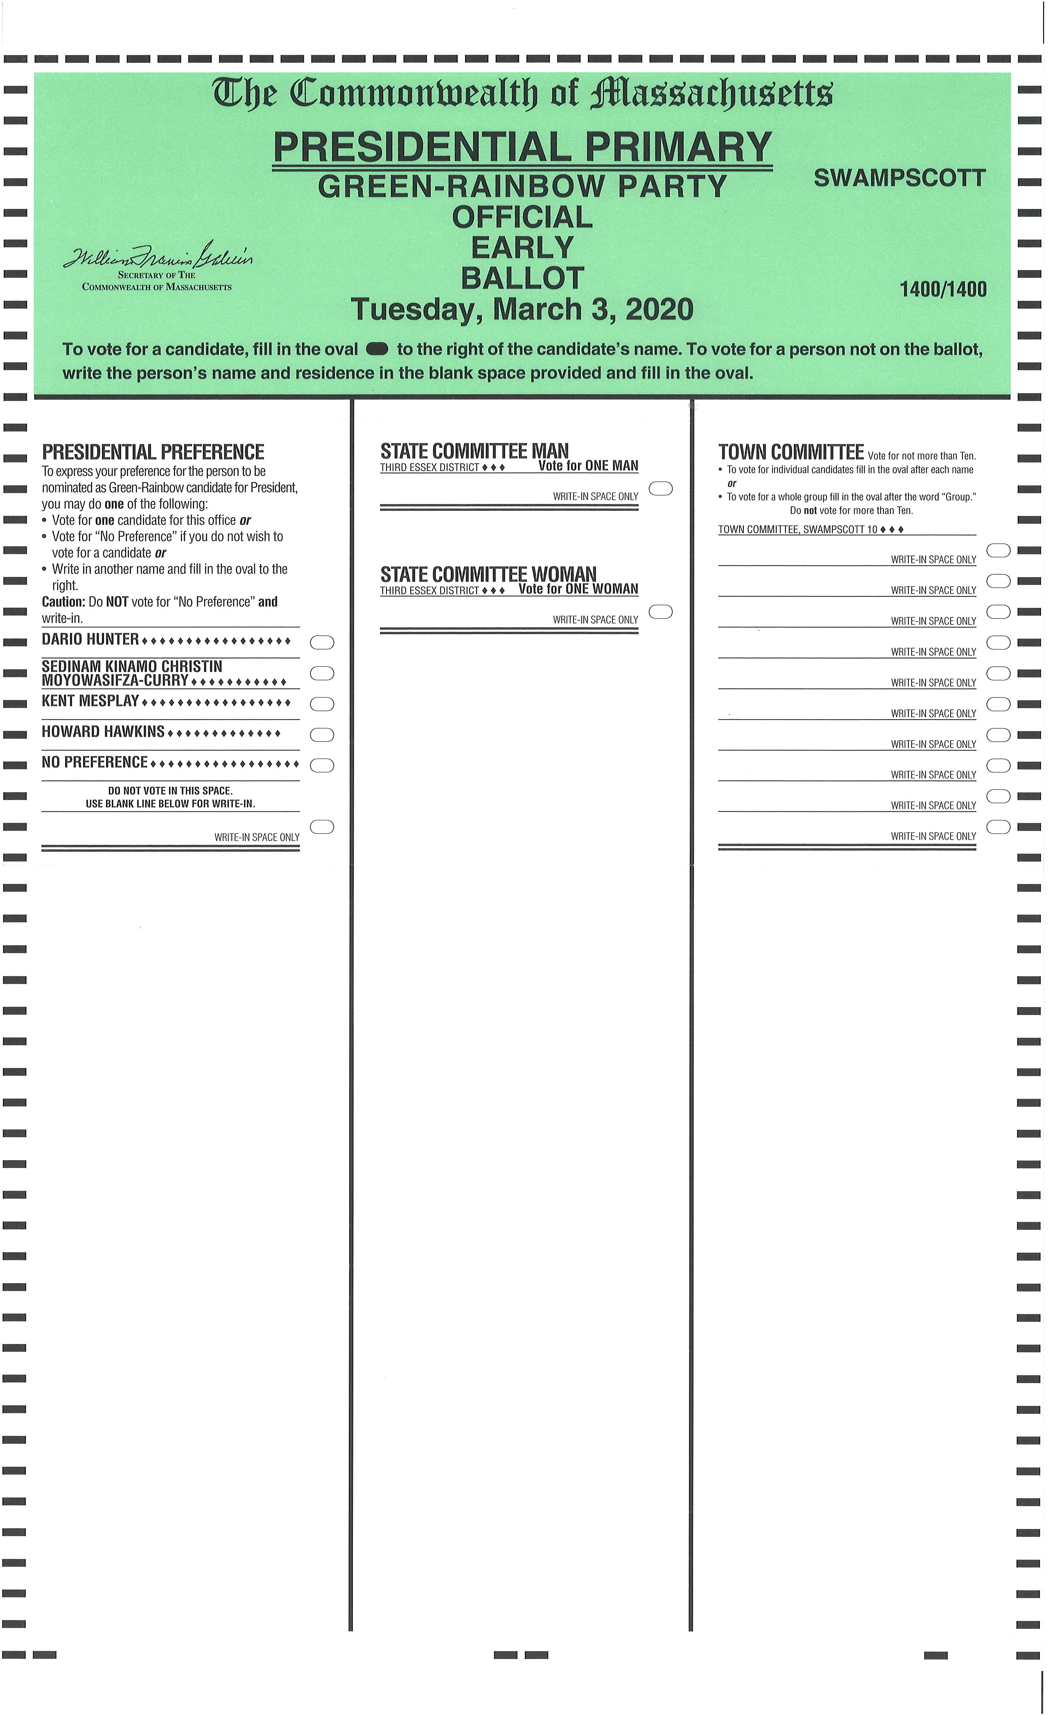

Slide 4
Absentee voting VS early voting
ABSENTEE VOTING
Excuse needed
Application needed
The voter or family member may apply
Deadline to apply: noon the day before election
EARLY VOTING
No excuse needed
No application needed unless requesting through the mail
Voter only must apply
Deadline to apply; last day of Early Voting

Slide 5
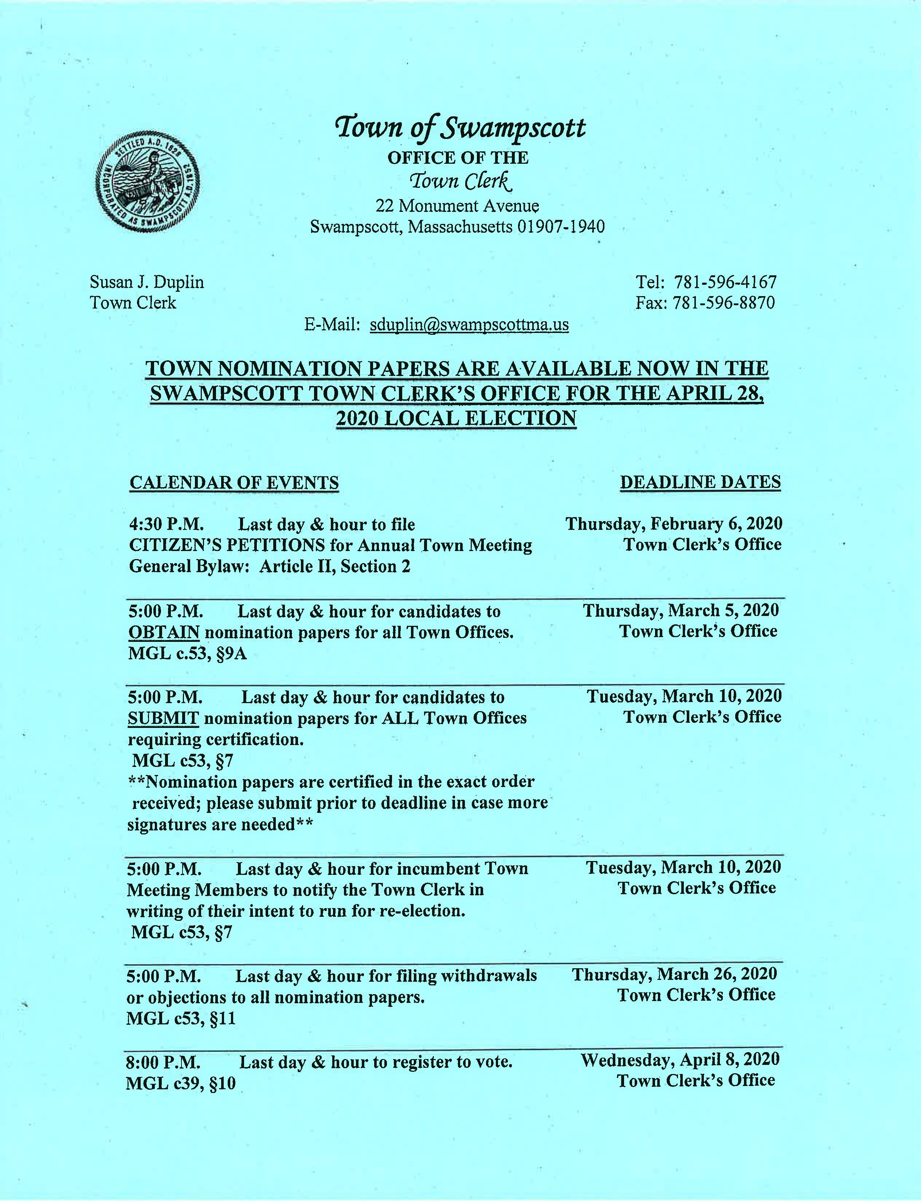
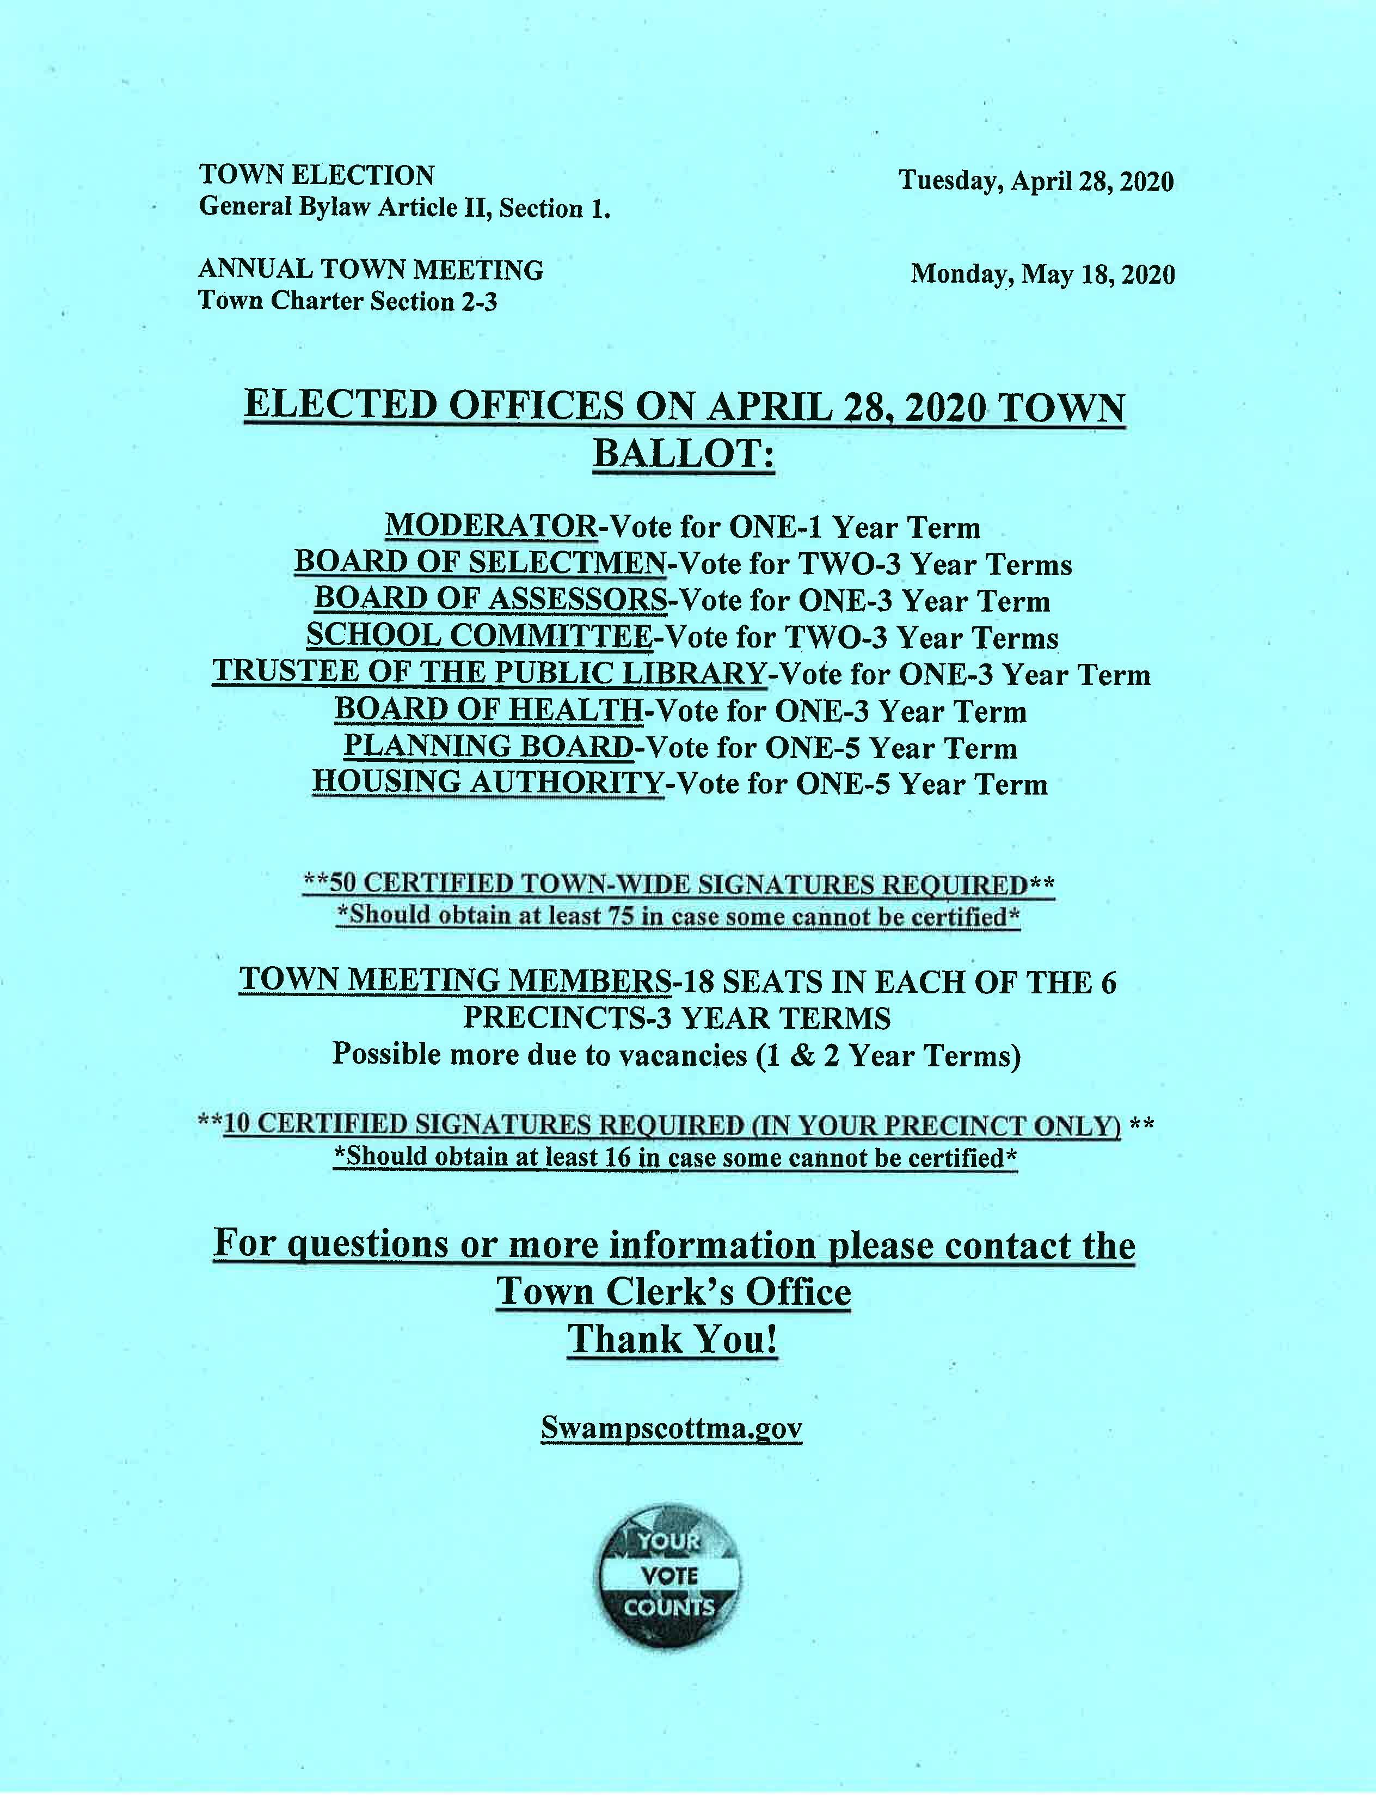
APRIL 28, 2020 LOCAL ELECTION

Slide 6
VOTER REGISTRATION
MUST BE 18 ON OR BEFORE ELECTION DAY, PRE-REGISTRATION ALLOWED
New law allows voter registration thru health agencies; MA Health & Health Connector
Voter Resources by visiting Secretary Galvin’s website: sec.state.ma.us or you may call or visit the Town Clerk’s Office
Don’t wait, check your voter status early!

Slide 7
Annual census & federal census
ANNUAL CENSUS
Mailing 2nd week of Feb.
Does not Register you to Vote!
Failure to return shall result in removal from the active voting list
Everyone in a household must be included on the Census
FEDERAL CENSUS
Separate from the Annual Street Census
Begins March 2020, everyone needs to be counted
Ensures municipalities receive their fair share of federal money and political representation
How? Online, phone, or mail

Slide 8
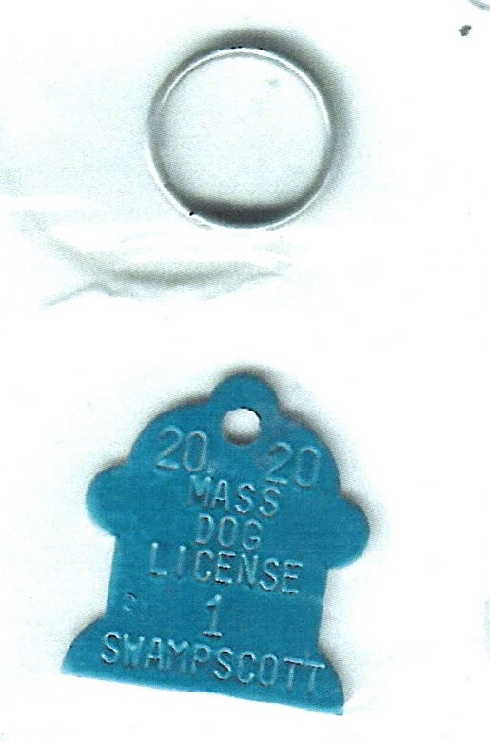
2020 dog licensing
Time to License your dog now!
3 Easy Ways to License: Online, By Mail, In person
Must provide proof of rabies
License by Feb. 29th to avoid a late fee
Licensed 1,100 last year

Slide 9
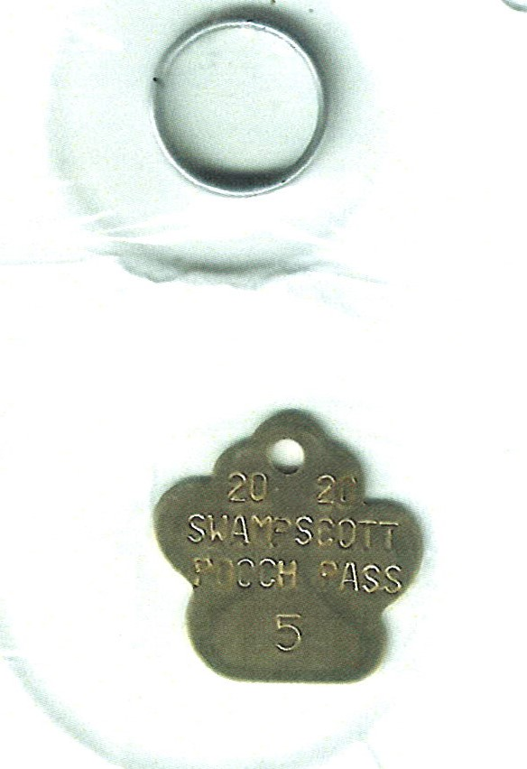
2020 pooch pass
Required to use the Dog Park
$5.00 for residents, $15 for Non-residents
Must be currently licensed & rabies up to date
3 Easy ways to license: Online, By Mail or In Person at Town Clerk’s Office
Issued 485 Pooch Passes last Year

Slide 10
Polling location change
MIDDLE SCHOOL PRECINCTS 5 & 6
WHY? SCHOOL SECURITY
Move Precinct 5 to First Church with Precincts 3 & 4?
Move Precinct 6 to Swampscott Town Hall?
Select Board must vote the change at least 20 days
All Voters affected will need to be notified by mail

Slide 11
I DON’T MAKE THIS STUFF UP, IT’S THE LAW!
Sue Duplin sduplin@swampscottma.gov
Brittney Jones bjones@swampscottma.gov
Town Clerk’s Office 781-596-4167
SEC Website: sec.state.ma.us
swampscottma.gov

